Slide 1

Income Level Prediction Using Machine Learning
Presented by [Your Institution Name]
Date: [Presentation Date]
mm
by mohamed mgdan

Slide 2

Introduction & Objectives
Predictive Goal
Classify whether income exceeds $50,000 annually.
Key Objectives
Build a classification model
Identify influence factors
Support decision-making

Slide 3
Problem Justification
Need for Automation
Benefits
Manual income assessment is slow and costly.
Faster personalized services
Efficient resource use
Enhanced policy targeting

Slide 4
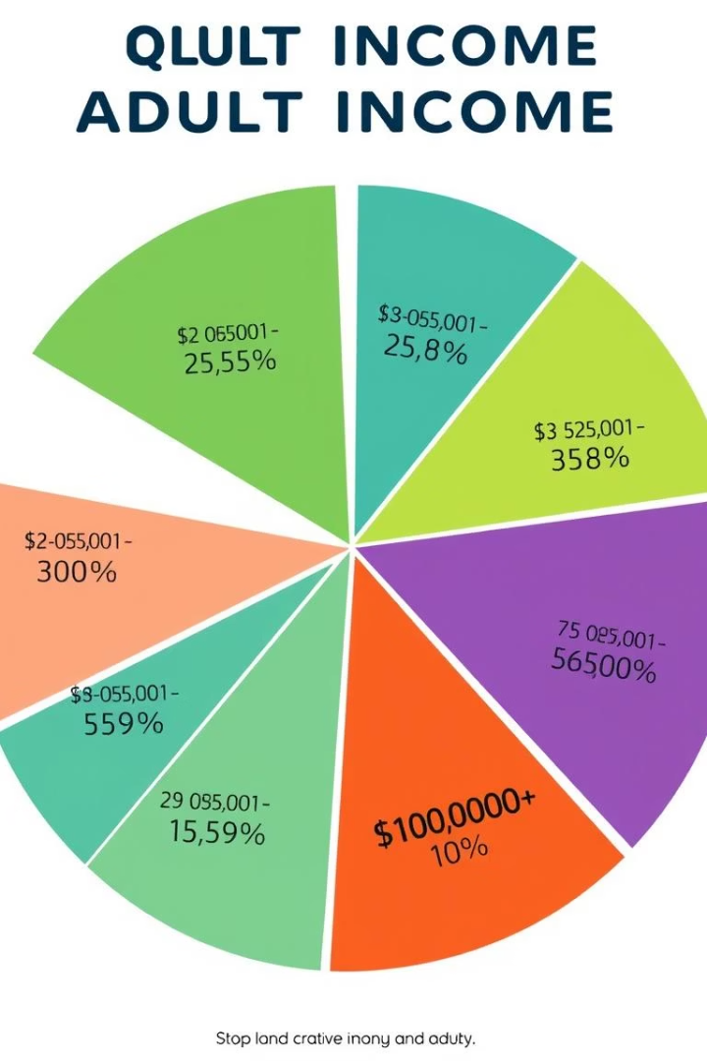
Dataset Description
Source
Kaggle: Adult Income Dataset with 48841 samples
Features
14 input variables including education, occupation
Target variable: Income >50K or <=50K

Slide 5
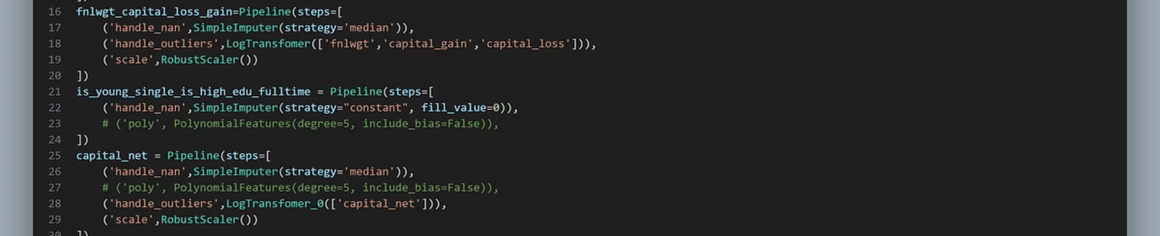
Data Preprocessing
Missing Data
Feature Encoding
Normalization
Imputed missing values in workclass and occupation.
Converted categorical variables like marital status and education.
Scaled numerical data such as age and hours-per-week.

Slide 6

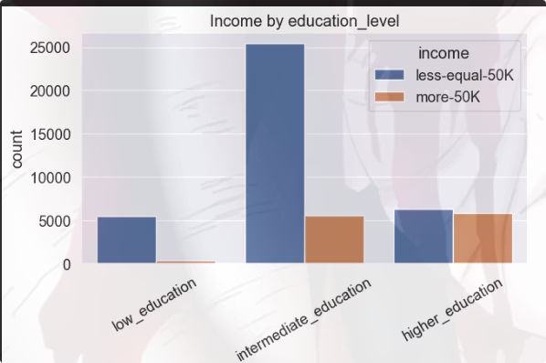
Exploratory Data Analysis (EDA)
Key Variables
Education Level
While individuals with higher or intermediate education levels tend to have a better chance of earning more than $50,000, education alone is not among the most influential factors in income prediction. Other features like occupation, hours worked per week, and age show a stronger impact on income level.

Slide 7

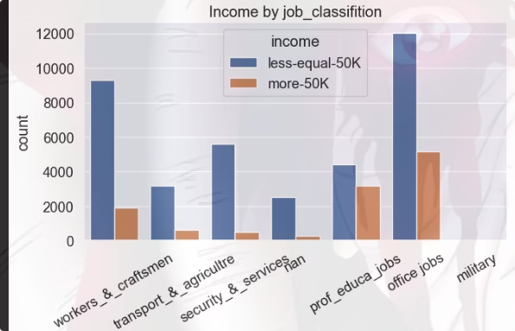
Exploratory Data Analysis (EDA)
Occupation type correlates with earnings
Office and administrative jobs have the highest proportion of individuals earning more than \$50,000.
However, this is not a definitive indicator income can still vary widely depending on other factors like experience, age, and hours worked.

Slide 8

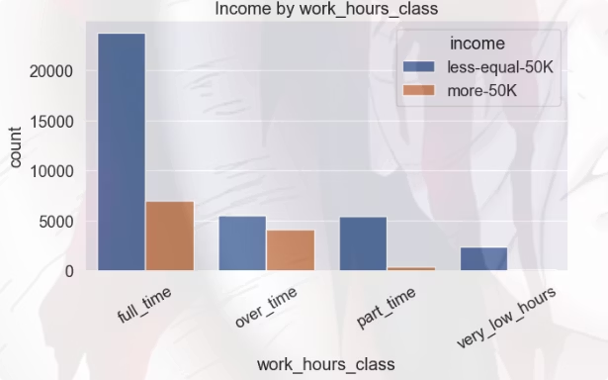
Exploratory Data Analysis (EDA)
Hours worked per week influence income category
People working full-time jobs are the most likely to earn more than \$50,000 annually.
However, this alone is not a reliable indicator, as income also depends on job type, education, and individual circumstances.

Slide 9
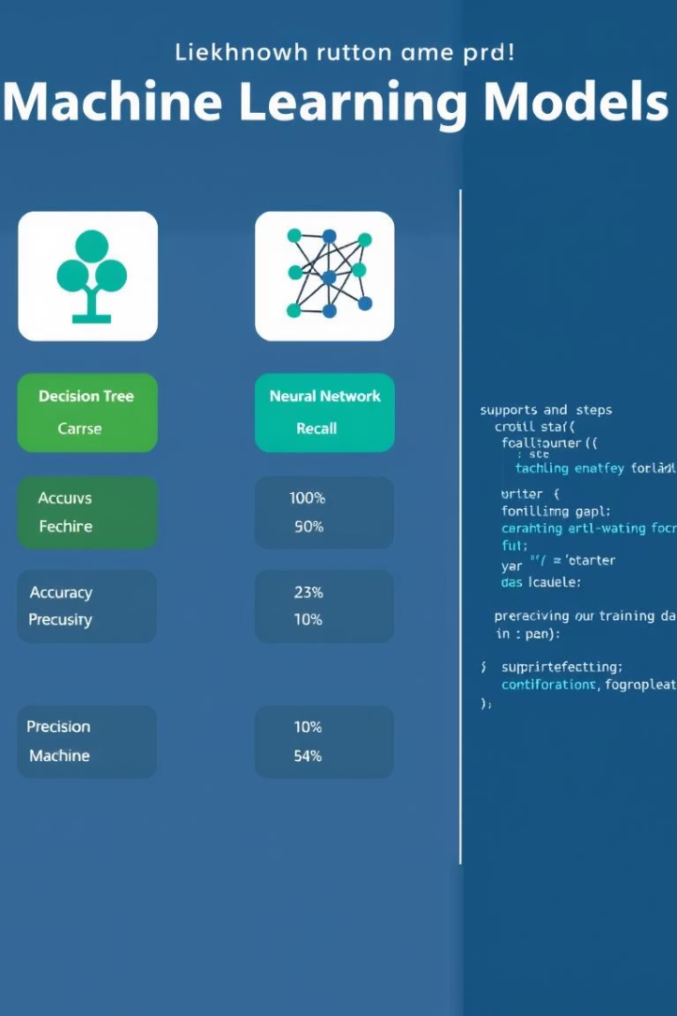



Model Selection & Training
Models Tested
StackingClassifier ,VotingClassifier , Random Forest
Selected Model
VotingClassifier by > KNeighbors
,HistGradientBoosting , RandomForest , XGBoost
Metrics
Test Accuracy:0.84
Test Precision: 0.66
Test Recall: 0.74
Test F1: 0.70

Slide 10

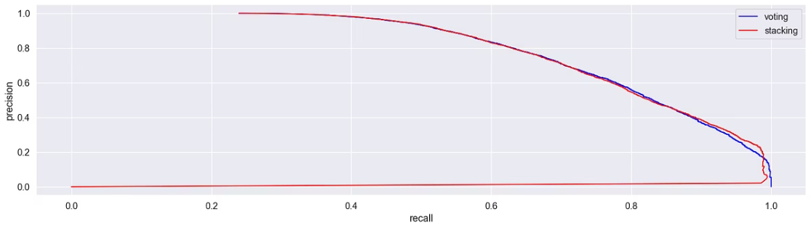
Model Evaluation
Evaluation Metrics
Visual Insights
Balanced precision and recall
Confusion matrix identifies classification errors
Strong true positive rates
PR curve measures sensitivity vs. specificity tradeoff
Effective discrimination in PR curve

Slide 11

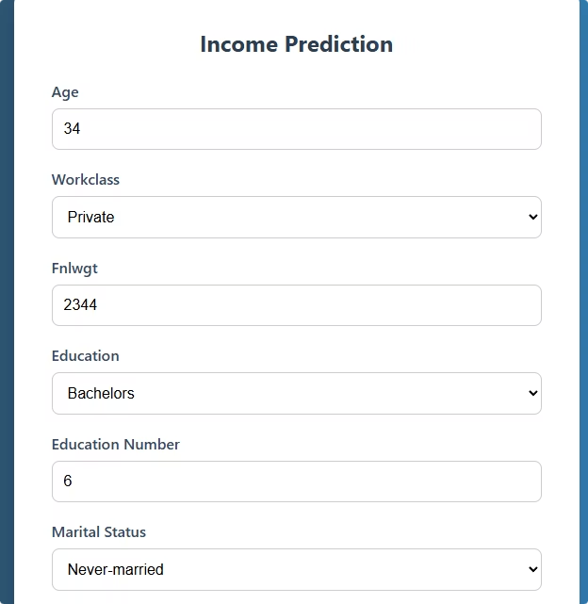
Limitations & Future Work
Challenges
Imbalanced data classes
Dataset lacks recent updates
Planned Enhancements
Deploy model as API service
Integrate real-time income data
Test on larger, diverse datasets
Model aids real-world income prediction effectively. Thank you!

